Slide 1
MIS 670 Final Project
Noah Modean / Charles Mayfield

Slide 2
Which console is best to invest in: Xbox1 or Ps4?
Using Twitter analytics, sentiment analysis, text analysis, and web crawling we collected and evaluated data to prove to companies which console they should invest in and customers which console they should purchase

Slide 3
Findings - Rating
Overall ratings are an important thing to factor into decision making whether that be for purchase or investment
Ps4
Overall Average Console Ranking: 8.6/10
Xbox 1
Overall Average Console Ranking: 8.2/10

Slide 4
Findings - Sentiment
Twitter analytics allowed us to see how people tweeting about the consoles felt about them
Ps4 – 107 Positive tweets, 45 Neutral tweets, 179 Negative tweets
Xbox 1 – 90 Positive tweets, 29 Neutral tweets, 87 Negative tweets

Slide 5

Findings - Sentiment
Ps4 had 107 negative tweets but also
179 negative tweets
Graphics, team, YouTube, and
BluRay were some of the most
important words found in these tweets

Slide 6
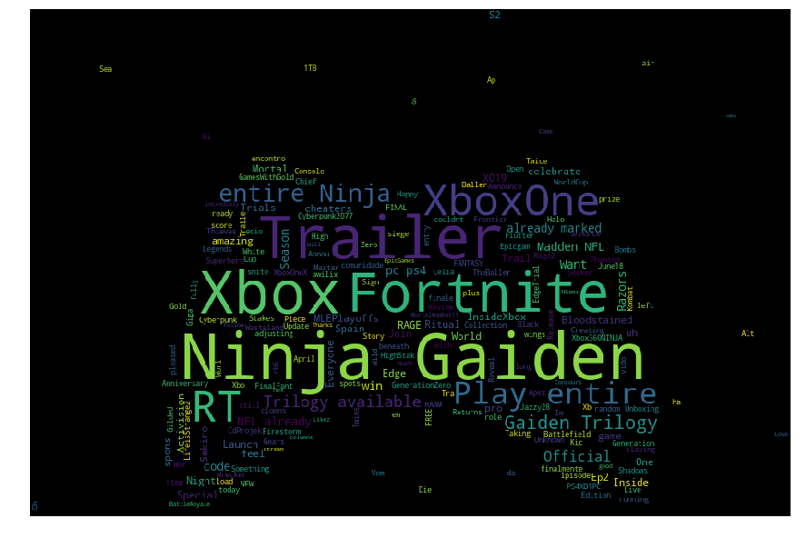
Findings – Sentiment (cont.)
While Xbox 1 had 90 positive tweets,
it also only had 87 negative tweets
Ninja, fortnite, Gaiden, and trailer
were some of the most important words from these tweets.

Slide 7
Findings – The Numbers
World wide sales (millions)
Ps4 – 95.47
Xbox1 – 43.78
NA sales (millions)
Ps4 – 31.96
Xbox1 – 27.46

Slide 8
Conclusion
Ratings – Ratings tell us that Ps4 Outright beats Xbox1
Tweets / Sentiment – Looking at tweets it seems that Xbox1 has a better ratio of positive to negative tweets even though there are more people tweeting about Ps4
Numbers – The numbers of sales show us that Ps4 is in fact more popular and looking at all of the data, would most likely be the better choice for investment or purchase unless you want an Xbox1 specific game

